Slide 1
SupaVac SV60/SV60V/SV110 Maintenance Training

Slide 2
SupaVac SV60/SV60V/SV110 Maintenance Training
2. Slide Index
3. Introduction
4. Basic System Operation
5. Typical Unit Installation
6. Basic Rules of Operation
7. Important Steps Before Use
8. Daily Service Routine
9. Main Components
10. Pump Control Components
11. Filter/ Lubricator Unit
12. Air Supply/ Control Valves
13. Knifegate & Actuator Components
14. Control Solenoids
15. Timer Block
16. Switches
17. Cleaning the Jetpack Housing
18. Maximising Performance
19. Pickup Nozzle Operation
20. Fast Basic Fault Finding
21. Vacuum Testing
22. Fault Finding Chart
23. Component Images

Slide 3
Introduction
This presentation has been designed to assist both the unit’s operator and the service technician, it aims to provide a basic level of information and support to ensure safe continuous day to day pumping operations are maintained.
The SupaVac vacuum loading solids pumps are 100% air powered & operated unit, therefore it is essential for correct operation that the unit is supplied with relatively good clean air at the required pressure and volume.
95% of all problems with the SupaVac system arise from simple incorrect supply issues.
A more in depth level of support for either fault finding or overhaul is available through SupaVac, contact support@supavac.com

Slide 4
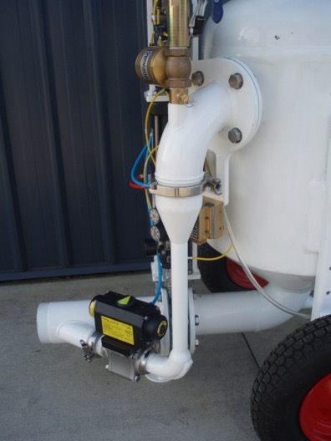
Basic System Operation
General Technical Features
Air powered and operated
Robust, Class 3 unfired pressure vessel
No internal workings
No moving parts in contact with product
Intrinsically safe, No electrics
Up to 26”HG of vacuum
All unit’s can be fixed or mobile
SupaVac pumps can be run dry indefinitely
Manual or automatic operation depending on model
SupaVac pumps operates by supplying a large volume of compressed air to a venturi, where the air is compressed and expanded rapidly. This in turn forms a “vapour plug” within the diffuser tube forming a high pressure on one side and a low on the other. As the air moves to equalise, a vacuum is formed and exerted via pipe work on the tank. The vacuum together with the high airflow generated by the velocity of the evacuating the air, form the power unit of the SupaVac Pump. Once full (a function controlled only via the pneumatic timers) the air to the venturi is halted and redirected through control valves into the tank expelling the recovered material under pressure.
Venturi Nozzle
(Not Shown)
Jet Pack Housing
Diffuser Tube

Slide 5
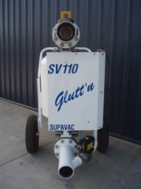
Typical Unit Installation
25MM Air Supply Line
75/100mm Diameter Suction Line (up to 50+ metres in length)
Typical sludge, thick flowable material to75mm diameter, Sg 1.2 - 3.2
Compressor Unit
Discharge Line 75/100mm Diameter
(up to 1000 metres in length depending on pump & material)
Aqueous Waste
SupaVac Pump
Containment Area

Slide 6
Basic Rules of Operation
The basic rules for the operation of any air powered equipment are the same
Compressed air is DANGEROUS always isolate and TAG OUT the equipment from the energy source and drain any residual air from the supply line prior to carrying out any maintenance or work on the unit.
Air equipment is supply sensitive, a reduction in pressure or volume will have a compounding reduction in pump performance. Consider other air operated equipment being added to the supply causing a drop in available air.
As AIR is the power source this needs to be reliable, if the supply quality is poor the filtration system will require a higher level of maintenance.
These are mechanical items, if YOU “FAIL TO SERVICE” the unit, it may “FAIL YOU IN SERVICE”.

Slide 7
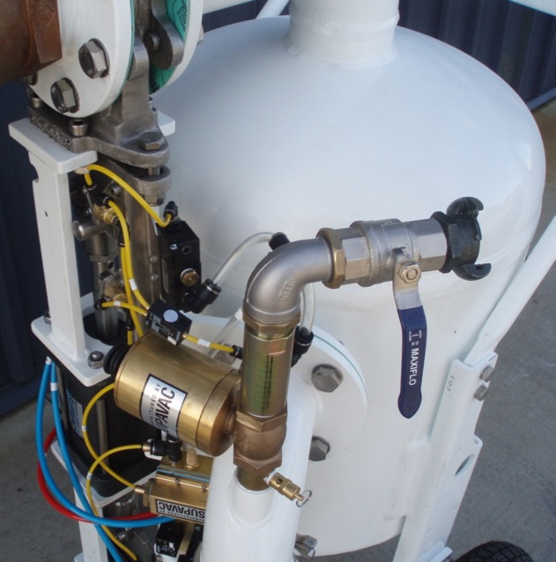
Important: Steps Before Use
Before working on any aspect of the pumps:
Isolate
Tag out
Ensure residual pressure has been exhausted by manually operating the safety valve
All procedures in this presentation assume correct isolation and prior removal of the covers
LOCATION OF THE SAFETY VALVE

Slide 8
Daily Service Routine
Daily servicing for every SupaVac unit is quick and simple
Check all the filters, and clean or change as required.
Check the oil lubricator and top up if required, oil in the system is for moisture displacement only and usage should be set at the absolute minimum feed rate.
Check all lines, suction, discharge and air supply to and from the unit for serviceability.
Carry out a visual check on the unit’s main components.
After switching the unit on, observe the function for several cycles to ensure all is correct including valve function micro switches actuators for smooth operation.
If the unit is running a 24/7 operation, carry out all the visual inspections as detailed above daily.
Estimated time: 5-10 minutes.

Slide 9
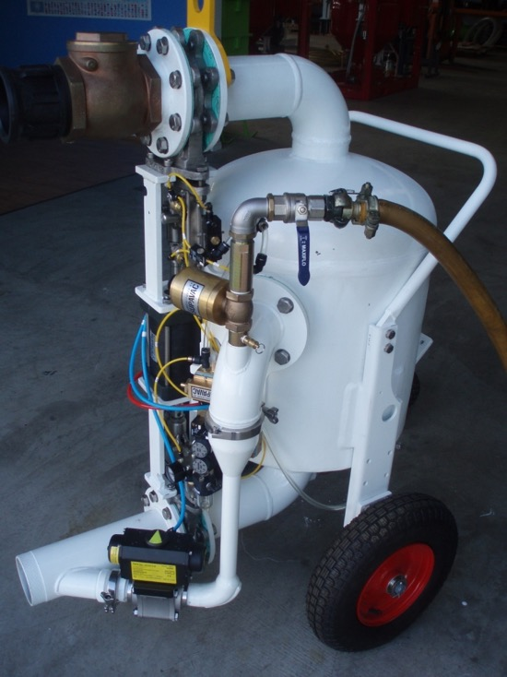
Main Components of SupaVac Pumps
SUCTION KNIFEGATE
SUCTION
MAIN AIR SUPPLY INLET
DOUBLE ACTUATOR
TANK
DISCHARGE KNIFEGATE
JET PACK
(VENTURI)
DIFFUSER
DISCHARGE
SV110 is shown

Slide 10
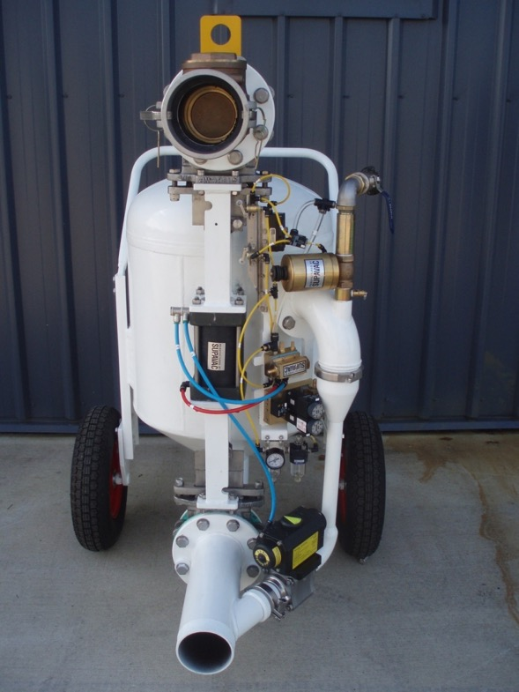
SupaVac Pump Control Components
All SupaVac solids pumps feature the same basic control components.
0-30 second load timers
0-30 second discharge timer
timer filter/lubricator unit
air actuated spring return control solenoids valves
air actuated globe valve
air actuated ball valve
micro switches
timer block
OR switches
Air actuated globe valve
Timer controls
Load/discharge
Air actuated spring return control solenoid valve
Timer filter/lubricator unit
Air actuated ball valve

Slide 11
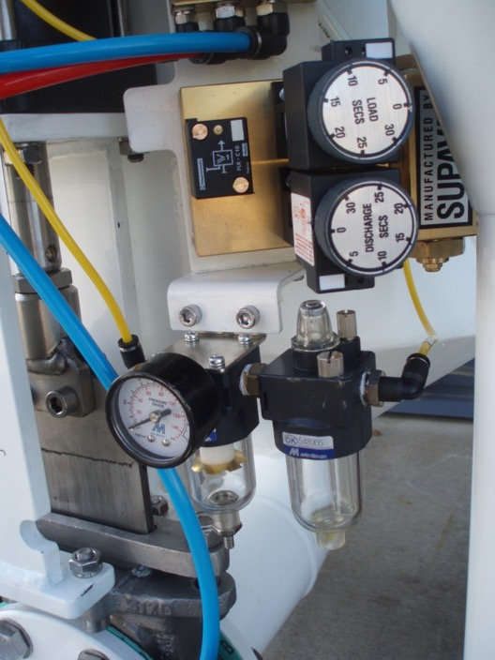
Filter / Lubricator Unit
It is critical to ensure the water trap or air dryer facility (if fitted) on the compressor are operating correctly. High volumes of condensation through the lines may result in SupaVac pump control issues.
It is recommended practice to drain all filters and renew the oil in the lubricators at the end of the operation, if the unit is to stand for a period. Water remaining in the air system will move through the controls via convection, this may result in start up issues bought on by calcification.
Oil Lubricators act to displace moisture ONLY
The pneumatic system is a dry system. Feed rate should be set to a minimum. Oil to be renewed on a “When Required” basis with Shell Tellus 20 or similar light grade.
Filter elements must be replaced on a regular basis.
Ensure Auto Drain function is working adequately, if no replace.
If no replacement available, crack fitting to allow manual drain whilst operating.

Slide 12
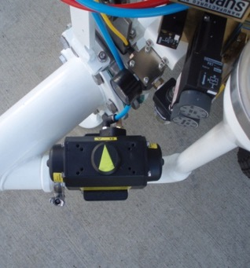
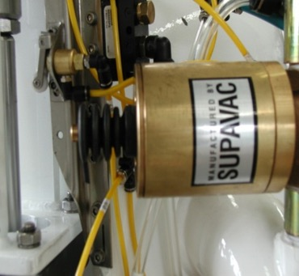
Air Supply / Control Valves
SupaVac uses two types of valves for air control, both are air actuated open, spring return closed.
Globe Valve The first is a Globe Valve, a simple piston configuration which has a single “o” ring on the piston and two “o” rings on the s/steel shaft. Air is ported into the base raising the seat (movement can be confirmed via the Indicator pin) which allows air to flow. When the air is removed the compression spring forces the seat closed, halting flow. This valve has been found to work under extremely poor conditions.
Rotary Ball Valve The Rotary Ball Valve features a simple sliding piston which with air on, through a keyway, rotates a ball valve to the open, with air removed a compression spring closes the valve. This can be visually confirmed via the Indicator Arrow.
Valve Actuator Silencer’s
Part No. SV460
Must be kept clear.
Globe Valve
Part No. SV433
Indicator pin
Remove dust seal and unscrew cap to access spring assembly
Valve air supply line and push fitting.
Rotary ball
Valve
Part No. SV616
Indicator Arrow
Warning: Spring compression on both valves is pre determined, running the system at pressures HIGHER than those recommended by SupaVac can cause valve function issues.

Slide 13
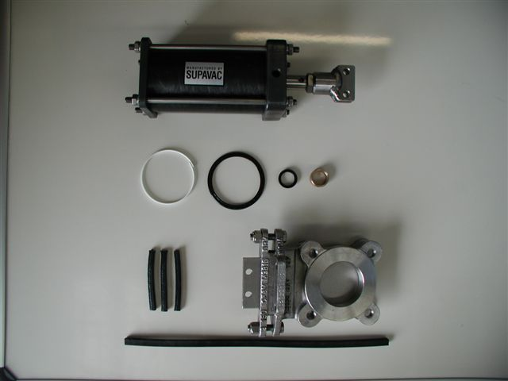
Knifegate & Actuator Components
The knifegate actuator utilises a simple piston motioned by air introduced via ¼ ports top and bottom. It contains a sealing and wiper ring, shaft seal and bush.
The knifegates are full face and are designed to function under both vacuum and pressure. As with any knifegate the packing box needs to be adjusted on a “as required” basis and this will depend on both the material being transferred and the duty. With the correct seal material fitted and the occasional tightening packing follower these units should give several months operation before requiring a full service.
The actuator’s piston seal and wiper ring can be replaced without the need to remove the entire unit, unscrewing the 4 cap nuts and removing both the cap and piston sleeve will allow easy access to these components. Under normal operating conditions the actuators are designed to carry out several million cycles.
¼ air port
Actuator Clevis
Actuator
Actuator Piston and seal kit SV481
Knifegate blade box packing
Knifegate
316 s/steel
Table E/D
Knifegate seal NBR

Slide 14
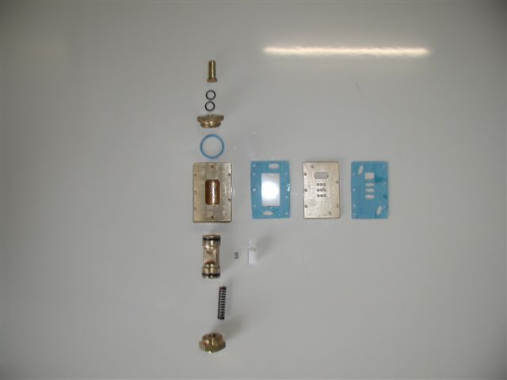
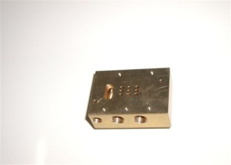
Control Solenoids
The solenoid should have NIL air leaks to function correctly.
The solenoid receives a signal through the port S indicated below, this is transferred through the gasket porting to the slide block via the piston. When actuated down and air is redirected from the supply inlet port to port A. When the signal is removed the compression spring returns the piston to it’s default port B.
A manual test may be carried out by pushing the manual button on the top of the solenoid and noting successful actuation or function. This solenoid is simple and robust it will perform under extremely poor air conditions, and the piston compression spring can be replaced rapidly in-situ if required by removing the end cap.
Manual actuator button
Check gaskets for air bleed between surfaces
Piston “O” Rings must be in sound condition
Supply inlet
Signal exhaust
Nylon slide block Note: Damage to face will cause solenoid to by-pass air from exhaust.
Supply exhaust
Piston compression spring rated at 100 PSI.
Signal air inlet port S
Actuated air outlet B
Note Ensure correct fitment of slide block compression spring
Default Air outlet A

Slide 15
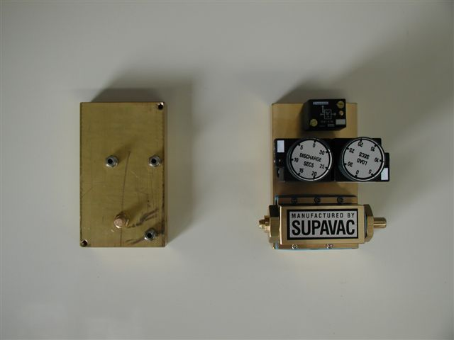
Timer Block
Latch Block
(Receives signal from either timer sends one signal to the solenoid)
The timer block receives it’s supply direct from the Filter/Lubricator.The signal is then transferred via the outlet ports A and B to the respective latch switch on the latch block. Here the signal is directed via common lines to initiate the action required.
The Discharge timer is “normally open”, hence the machine receives the signal to discharge immediately the timer block is engaged. The Load timer is “normally closed” actuated open. To quick check a Load timer is working correctly adjust the setting to 10-15 sec and actuate the solenoid manual button once the unit is in the load cycle, should the unit fail to switch to Discharge once timed out the Load timer is faulty. If the Load timer is set and functioning correctly and the unit fails to switch from discharge to load and air pressure is above 75 psi the discharge timer is faulty.
Discharge Timer signal outlet B
Load Timer signal outlet A
Load Timer
0-30 sec
(Normally closed)
Setting indicator
Timer Solenoid exhaust
Discharge Timer 0-30 sec
(Normally open)
Timer Block
Supply inlet
Timer solenoid with manual button
NOTE: If a timer begins to short cycle a small sintered bronze filter located in the base can be removed and cleaned with compressed air. A decal on the timer illustrates this procedure.

Slide 16
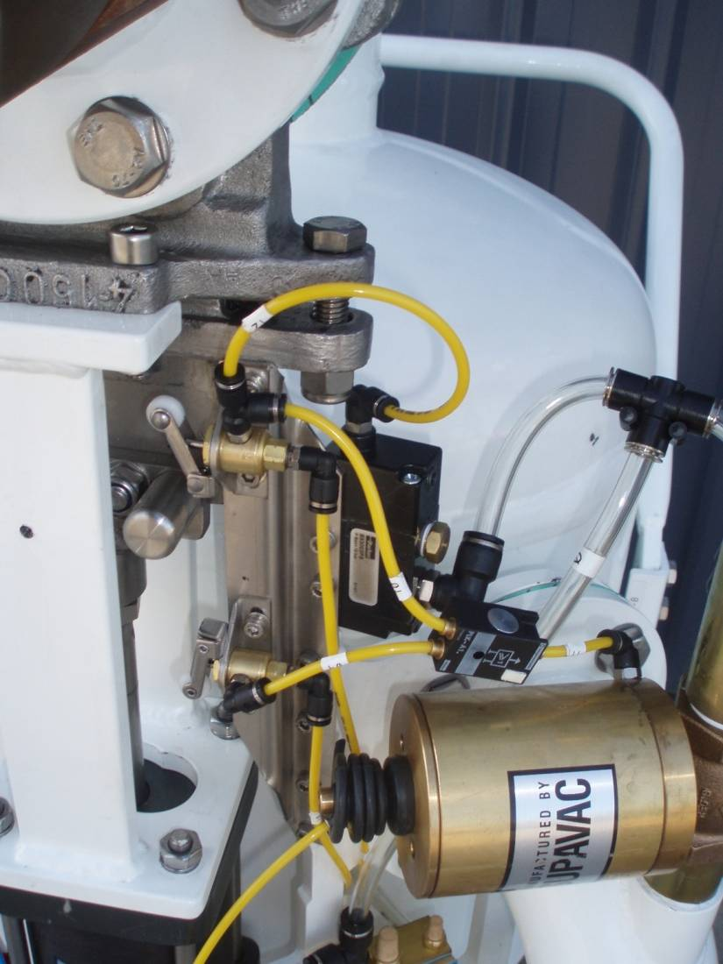
Switches
OR SWITCHES
Control the flow of air by allowing the air to only flow in one direction.
There are two types used on the pumps.
Solid mount and hose mount.
MICRO SWITCHES
The micro switches are mounted on the actuator mounting arm and signal when the knife gate is fully home in either discharge or suction.
MICROSWITCH
OR SWITCH
MICROSWITCH

Slide 17
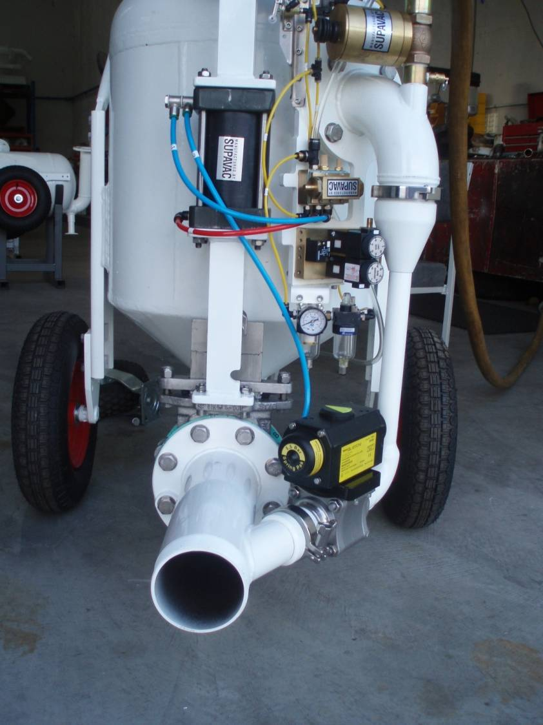
Cleaning the Jetpack Housing
3. Remove large clamp
Remove control hose from the rotary ball valve
Remove small triclover clamp from the base of the diffuser
Remove the large clamp from the diffuser.
Check for blockages in the diffuser housing.
Check for blockage of the venturi and housing
Installation is a reverse of the above checking that the rubber gaskets are in the correct place.
1. Remove Control Hose
2. Remove small clamp

Slide 18
Maximising Performance
To ensure the unit’s performance is maximised follow these guidelines,
Ensure the unit has been properly serviced and all components are in sound working condition prior to commencing any operation.
It is critical to the success of the operation that the air supply is both adequate and reliable for the job at hand.
Follow the support information, read the manual, view the CD and be familiar with the equipment, you don’t want to learn on the run.
Inspect the set up/installation and apply common sense, if it doesn’t look right there is a good chance it isn’t, if unsure ask the question.
Once operational, watch, listen and learn as minor adjustments in the unit’s operation may deliver large productivity outcomes. I.E. a few seconds of timing adjustment in a 24/7 operation can add up to may tonnes of product throughput.
In the event of a functional problem respond quickly, but don’t panic and don’t assume if unsure as to the cause, carry out the 5 quick steps to fault find fast. It is not advisable to change out any component without first carrying out the above steps.

Slide 19
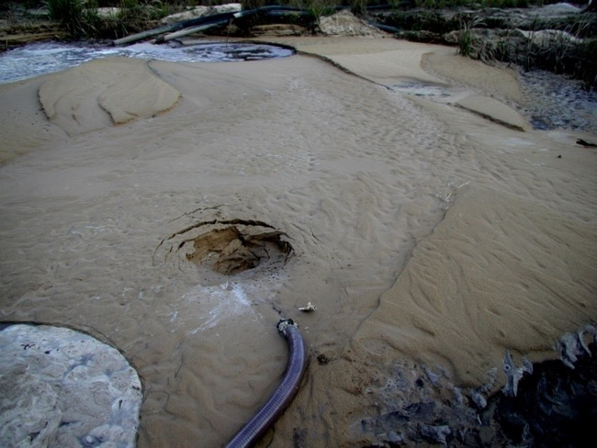
Pickup Nozzle Operation
The pick up nozzle primary purpose is to allow the operator to direct the point of suction. A small valve located on the handle when opened allows ambient air to be drawn in under vacuum and mix with the product within the nozzle. This in-turn allows the material to be pneumatically conveyed back to the pump rather than drawn under pure vacuum alone.
This is particularly helpful when the material is extremely viscous or the head of the lift is greater than the corresponding vacuum level generated.
A floor cleaning tool, inline eductor and Boosta attachment are available to either assist or enhance the nozzle and units performance.
Handle valve allows ambient ONLY air to be drawn in to assist in carrying the product back to the pump.
On the recovery/vacuum side material can have a very high solids content but must be flowable

Slide 20
Fast Basic Fault Finding
If the SupaVac pump has a fault, use this these 5 quick steps to locate and/or rectify it,
Supply, is supply correct? Check the air pressure on the control air pressure gauge to ensure the correct pressure is available while the unit is in operation. To remove all doubt, isolate the control system air from main supply and check function, if the problem remains it is a control system fault.
Blocked hoses – Check that the discharge and delivery hoses aren’t blocked.
No Suction - Check rotary ball valve is fully open, indicated by arrow on top of the valve.
Action, manually push each solenoid button, if the corresponding Knifegate actuator moves then move to Signal, if it fails the problem is in either the solenoid or actuator/knifegate
Air, visually check the corresponding Air control valve, does the indicator Arrow/Pin show full movement? If No check for Signal if signal is strong remove the valves silencer if still no movement replace or service that air valve. If Yes call SupaVac +61 2 9618 6777

Slide 21
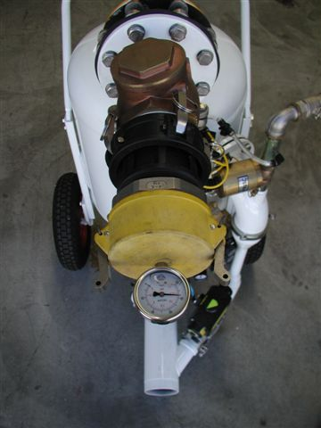
Vacuum Testing
It is essential to ensure the unit is performing correctly to carry out a vacuum test periodically. A vacuum test can be used to quickly confirm several function/performance issues, these are:
Knifegate valve seal and blade box follower condition
Rotary or Globe valve seat condition
Venturi nozzle performance
Flange gasket/seal condition
It will be impossible for the unit to reach it’s full vacuum potential if any of the above are at fault. You cannot pull full vacuum on a vessel with a leak.
I.E. Vacuum will be noticeably down if a Globe or Rotary valve is allowing compressed air to enter the tank whilst the tank is under vacuum.
NOTE: It is recommended that each operation have a simple vacuum tester at their disposal to assist in rapid fault diagnosis.

Slide 22
Fault Finding Chart

Slide 24
www.supavac.com

